Slide 1
Data Warehouse Solution for Sales and Inventory Management
Guided by:
Dr.G.Mariammal

Slide 2
Team Members
G Charan Kumar Naidu 99210042136
N Vyshnavi 9921004942

Slide 3
Abstract
In today's highly competitive business environment, managing sales and inventory data is critical for business success. A data warehouse solution can provide businesses with a central repository for their sales and inventory data, enabling them to make informed decisions based on accurate and timely information.
This project enables businesses to analyze the data and gain insights into their sales and inventory performance.
The outcome of this project will be a data warehouse solution that can provide businesses with accurate, consistent, and timely data to support their decision-making processes.

Slide 4
Introduction
In today's highly competitive business environment, managing sales and inventory data is critical for business success. A data warehouse solution can provide businesses with a central repository for their sales and inventory data, enabling them to make informed decisions based on accurate and timely information.
The project involves gathering data from various sources, transforming it into a common format, and loading it into the data warehouse. A data model will be designed and implemented to represent the data in a meaningful way. Finally, visualization tools like Tableau will be used to create reports and dashboards, enabling businesses to analyze the data and gain insights into their sales and inventory performance.

Slide 5
Aim & Objective
The aim of this project is to develop a data warehouse solution for sales and inventory management using ETL, data warehousing, and visualization tools like Power BI.
Objectives:
Gather data from various Sources
Transform Data
Load data
Data modelling
Data visualization

Slide 6
Tools used
Tools used in this project are:
R Programing
My SQL
Tableau Desktop

Slide 7
Methodology
1.Extract data
The dataset for sales Analysis contains Product data, Quantity data and Sales data.
The datasets for sales analysis were obtained from Kaggle.
This sales dataset contains 10000 rows of sales records with sales details from January 2019 to December 2022.

Slide 8
Methodology
2.Transform data
Sales Analysis dataset consists of some null values and empty spaces.
They are get pre-processed using some methods in the R programming language like plyr and dplyr packages.
Then the data get transformed and added into the Tableau Desktop.

Slide 9
Methodology
3.Load data
After the data has been transformed it will be loaded into the tableau Desktop.
After the data get loaded multiple tables get linked using joins in Tableau desktop.

Slide 10
Creative reports in Tableau
Sales Sparkline
Profit Sparkline
Quantity Sparkline
Sales and Profit distribution by State
States above and below the average Sales
States above and below the average Profit
Monthly sales by segment
Total Sales by Location and Manager

Slide 11
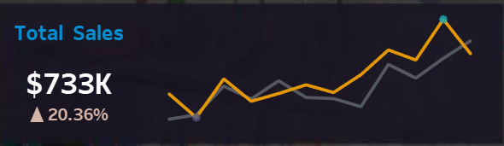
Creative reports in Tableau
Sales Sparkline

Slide 12
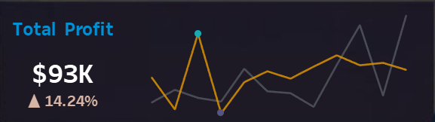
Creative reports in Tableau
Profit Sparkline

Slide 13
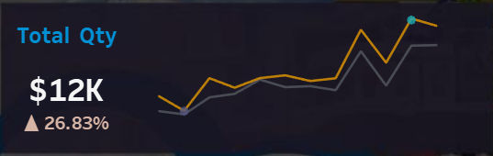
Creative reports in Tableau
Quantity Sparkline

Slide 14
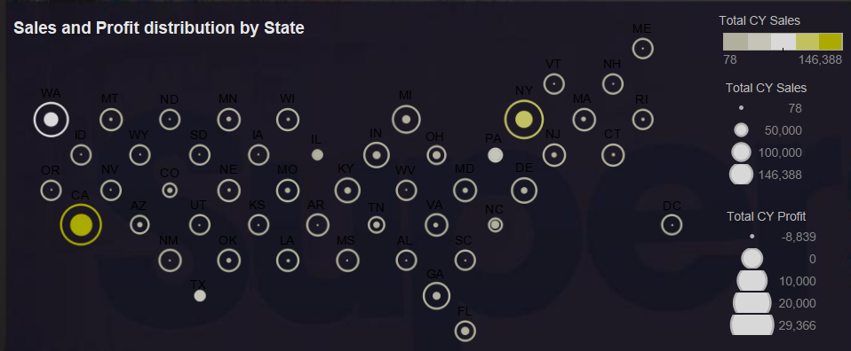
Creative reports in Tableau
Sales and Profit distribution by State

Slide 15
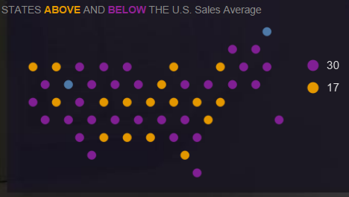
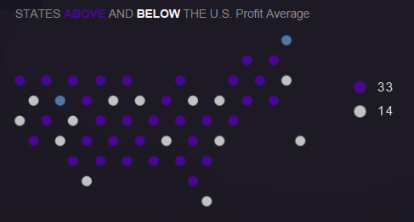
Creative reports in Tableau
States above and below the average Sales and average Profit

Slide 16
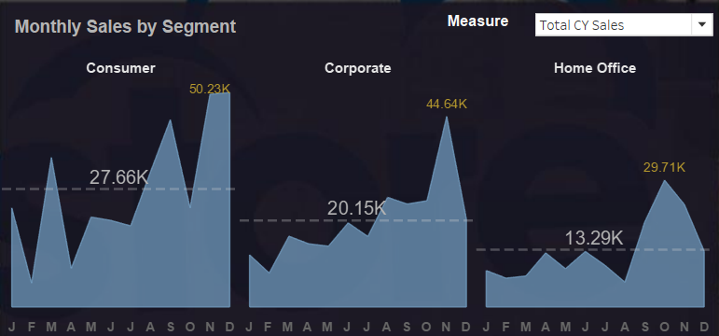
Creative reports in Tableau
Monthly sales by segment

Slide 17
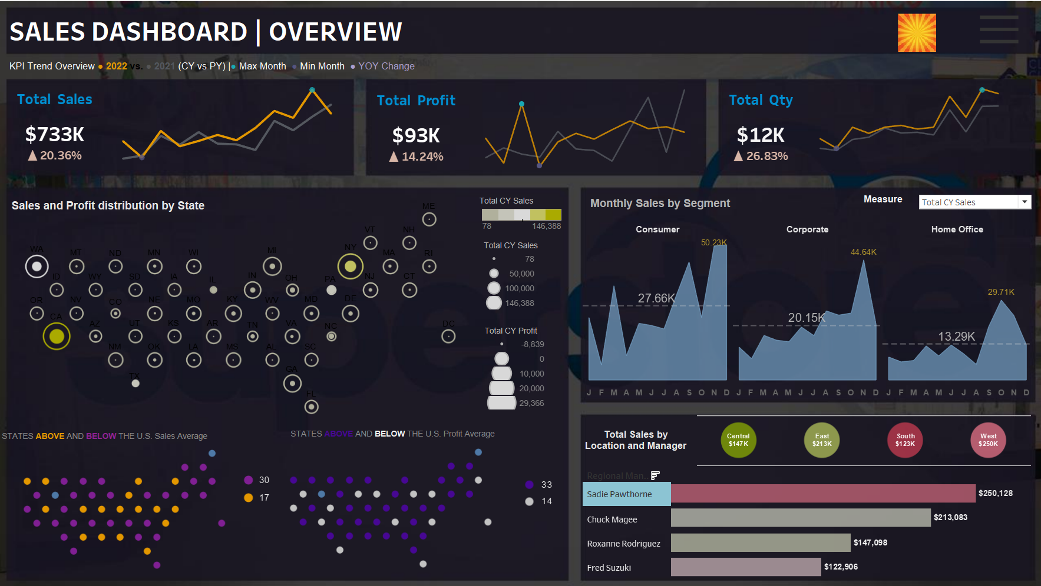
Creative reports in Tableau
Dash Board

Slide 18
Conclusion
The development of a data warehouse solution for sales and inventory management can provide businesses with significant benefits, including improved data quality, increased efficiency, and better decision-making.
Overall, this project has demonstrated the importance of data warehousing and visualization tools in managing sales and inventory data effectively. By providing businesses with a data warehouse solution, this project has enabled them to make informed decisions based on accurate and timely information, ultimately leading to improved business performance and success.

Slide 19
Thank you

